Slide 1
AWS Transit Networking
ACE Technical Team

Slide 2
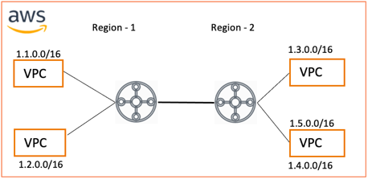

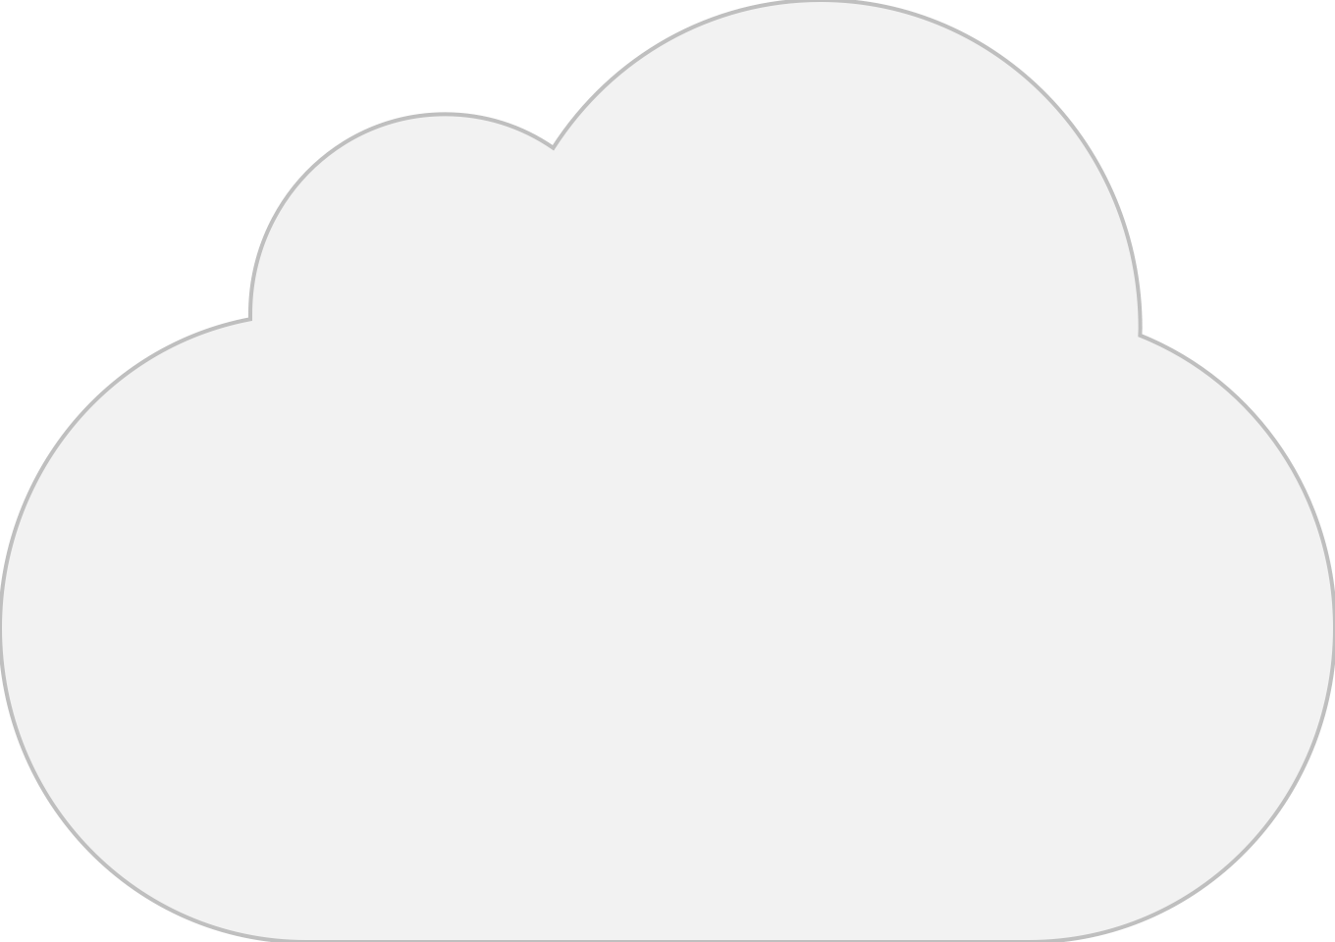





Transit Architecture Options in AWS with Aviatrix
Aviatrix Full-Blown Solution
Aviatrix Orchestrated AWS Transit Gateway
Native/DIY AWS Transit Options
VPC
VPC
VPC
VPC
Region - 1
Region - 2
1.1.0.0/16
1.3.0.0/16
VPC
VPC
Region 1
1.5.0.0/16
Region 2
Or 2nd CSP
VPC
VPC
1.2.0.0/16
1.4.0.0/16
BGP
Data Center
Aviatrix Orchestrated

Slide 3
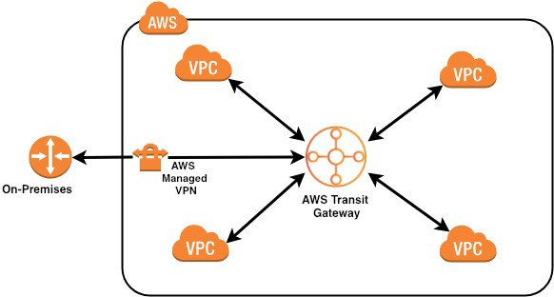
AWS Transit Gateway
Transit for VPC-to-VPC communication
“Black box” very little visibility
Manual VPC routing table management
Limited routing capability
Limited (static), multi-region support
Complex Segmentation
No overlapping IP support
Complicated L4-7 firewall insertion
No CIDR Summarization
Prod
20 CIDRs
100 CIDRs
Dev

Slide 4



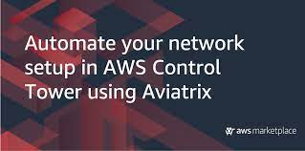
Aviatrix Orchestrated AWS Transit Gateway
Removes burden of route table management
Automatically create, update & manage VPC route tables
Propagates on-prem BGP routes to VPCs
New CIDRs/VPC routes updated on all other VPCs
Simplifies sharing AWS TGW between accounts
Manages AWS TGW route tables, domains, propagations etc.
Adds route approvals and traffic engineering options
Dynamic Routing for Multi-Region/Multi-Transit Gateway
Advanced capabilities like Security Domains
High performance and scalable Next-Generation L4-7 firewalls
Line-rate encryption to on-prem
Simplified Terraform Provider that works cross region
AWS
1.1.0.0/16
1.3.0.0/16
VPC
VPC
Prod
1.2.0.0/16
1.5.0.0/16
Security VPC
VPC
1.4.0.0/16
Dev
BGP
Data Center

Slide 5






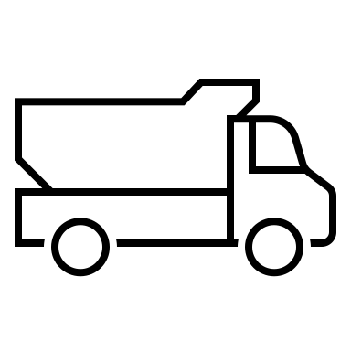
The Brownfield scenario: What is a Cloud Networking Backbone ?
A Cloud Network Backbone consists of the infrastructure that provides secure connectivity between any combination of cloud environments (inter-region, inter-cloud), on-prem data centers, colocation or carrier neutral facilities, SD-WAN and other branch connections, partner networks and external service providers or consumers.
Region A
Region B
Multicloud
Data
Center
Equinix/
Colo
Sites
Retail / Branch
Partners

Slide 6
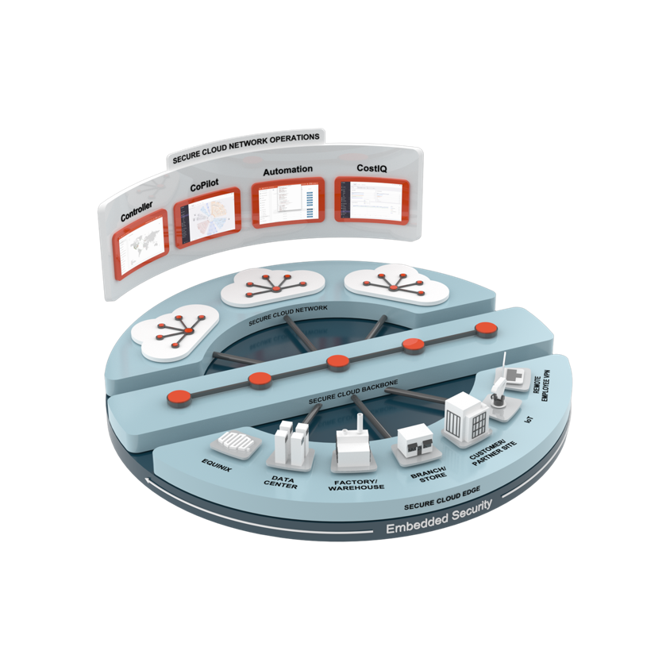
Aviatrix Secure Cloud Networking
Cloud Agility and Automation with Enterprise-Grade Resiliency and Security
Secure Cloud Network
Secure Cloud Backbone
Secure Cloud Edge
Aviatrix Secure Cloud Network Backbone
Embedded Security
Secure Cloud Network Operations

Slide 7
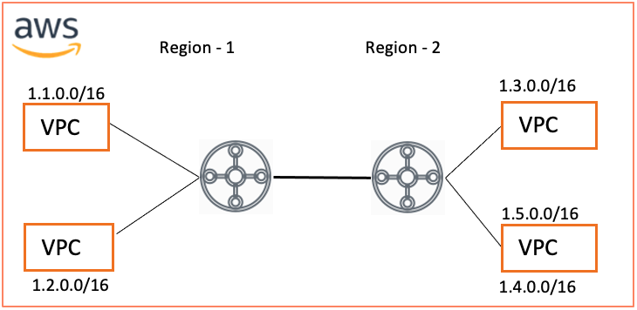
Native AWS Transit Gateway - Enterprise Requirements
Deep Visibility & Troubleshooting
Inside AWS
Single or multiple AWS Transit Gateways
Single or multiple regions
Segment traffic
Dynamic Routing
Internet Egress
External Connectivity
On-Prem DC/Colo connectivity
3rd Party Connectivity
Overlapping IP Support
Extend to different cloud provider

Slide 8
Deep Visibility & Troubleshooting
Quick Reference Feature Mapping on How Aviatrix Secure Cloud Backbone Enhances AWS Transit Gateway
Supporting Capability | AWS Transit Gateway | AWS Cloud WAN | Aviatrix Backbone
Ping, Traceroute, Tracepath | N | N | Y
Packet Capture | N | N | Y
NetFlow | N | N | Y
Overlapping IP Support | N | N | Y
End-to-end Latency Monitoring (Inter-TGW, Inter-Region etc.) | N | N | Y
BGP Support for Inter-Region peering | N | Y | Y
Same Security Segment across regions | N | Y | Y
Native support of 20+ routes over AWS Direct Connect | N | N | Y
Native support of Encryption over AWS Direct Connect | N | N | Y
Extend Same Routing Controls & Visibility to DC, Edge, Branch | N | N | Y
Same architecture extendable to other cloud providers | N | N | Y
Single terraform to automate networking across clouds | N | N | Y

Slide 9
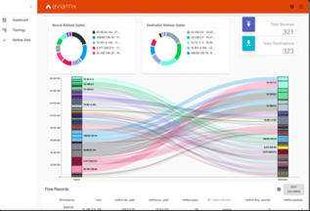
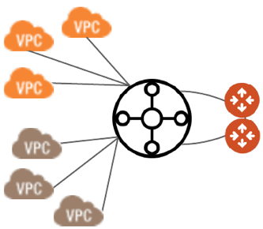


Enhance Visibility & Troubleshooting
Challenge:
Troubleshooting AWS TGW increases MTTR
Lack of tools (Netflow, Packet Capture, Ping etc.)
Solution:
Attach Aviatrix Transit to AWS Transit Gateway
High-speed links
Route inter-route table traffic via Aviatrix Transit
Fully automated
Enhance Visibility and Troubleshooting capabilities
Reduce MTTR and gain visibility by leveraging
Netflow,
Packet Capture,
Ping
and many other tools
Packet Capture
Troubleshooting Tools

Slide 10
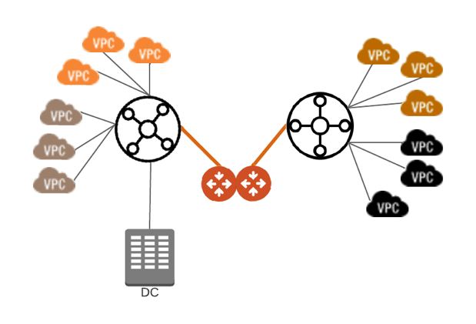
Connecting Multiple AWS Transit Gateways in Same Region
Challenge:
Multiple teams have built their own AWS Transit Gateways
IT Teams have no visibility in the traffic
Need the ability to see the traffic and perform troubleshooting as needed
Lack of tools (Netflow, Packet Capture, Ping etc.)
Solution:
Use Aviatrix Transit to connect Multiple AWS Transit Gateways
High Performance connectivity
Enhance Visibility and Troubleshooting capabilities
Access Netflow, Packet Capture, Ping and many other tools to reduce MTTR and gain visibility

Slide 11
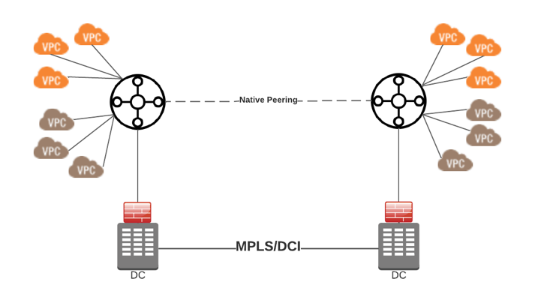
Multi-Region Peering Challenges
1- Visibility and Monitoring Challenges
Limited visibility into inter-region AWS Transit Gateway traffic
No way to monitor latency to help solve performance issues
Lack of tools (Netflow, Packet Capture, Ping etc.)
2- Cost and Latency Challenges:
Using DCI/MPLS for inter region connectivity
Using on-prem FWs to get logging, visibility and troubleshooting capabilities
Increases latency and cost
Complicates routing and adds load to DCI connection
1
2

Slide 12
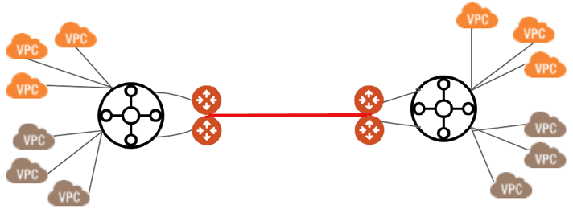
Solution for Multi-Region Connectivity Challenges
Solution:
Use Aviatrix Cloud Network Backbone for inter-region connectivity
Reduce latency for inter-region traffic
Reduce cost (Direct Connect data charges, DCI/MPLS)
Gain visibility and troubleshooting capabilities
Enhance Visibility and Troubleshooting capabilities for multi-region AWS Transit Gateway
Inter-region Latency monitoring
Access Netflow, Packet Capture, Ping and many other tools to reduce MTTR and gain visibility

Slide 13
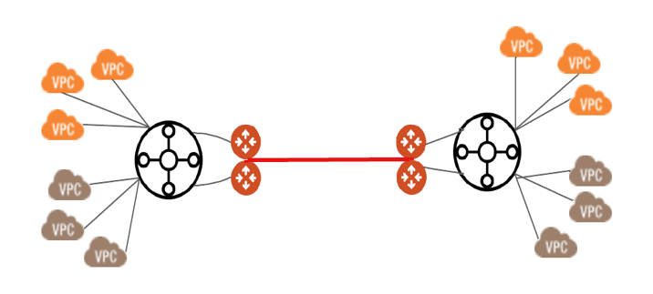
Dynamic Routing for Inter-region Peering
Challenge:
Native TGW Peering require static routing
Need constant caring and feeding
2+ regions become complex to manage
Adding/removing VPCs may need manual route updates otherwise you may end up with blackhole routes
Solution:
Dynamic Routing
Support for BGP
Add any number of regions
Simplified Visibility
BGP
BGP

Slide 14
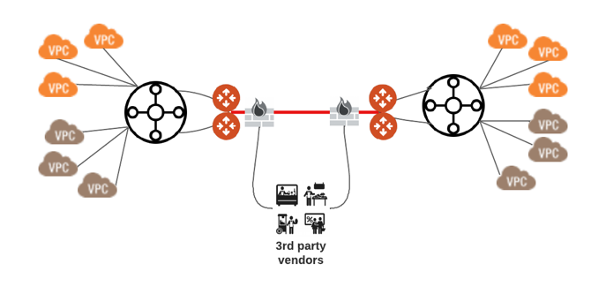
Inserting NextGen Firewalls
Challenge:
Inserting NGFW for inter-region, inter-cloud or 3rd party client/vendor connections
Scaling of firewalls
Complex routing for AWS Gateway Load Balancer
Solution:
Aviatrix Backbone can integrate with any 3rd party NGFW
Backbone manages the load balancing and steering of traffic.
Easily add/remove Firewalls

Slide 15
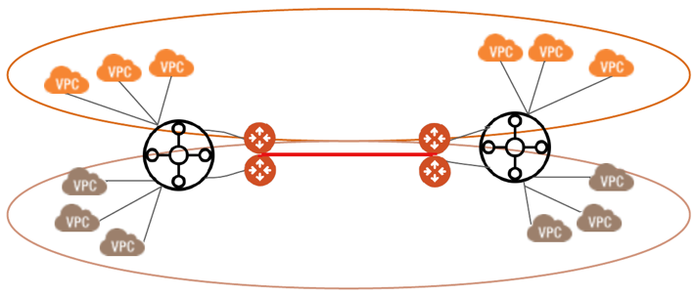
Extend Security Segments Across Regions
Challenge:
Security Segments are limited to a single AWS TGW
Require AWS Cloud WAN migration to extend security domains
Solution:
Aviatrix Secure Cloud Backbone connects to local AWS TGW Route Tables and extends the segment to other AWS TGWs
Get full visualization of security segments
Create policies to connect segments as needed
Track flows between segments with Netflow
Production Segment
Development Segment

Slide 16
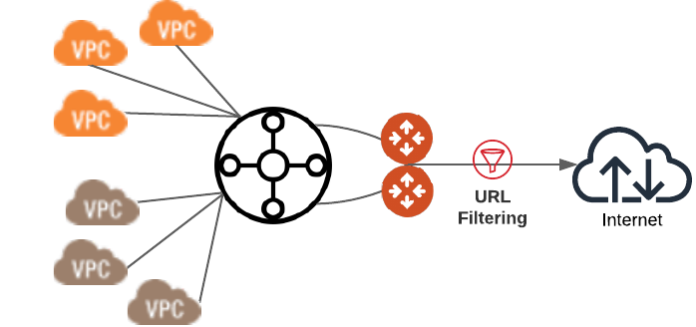
Reduce Cost for Internet Egress Inspection
Challenge:
Internet Egress Traffic control
Expensive NGFW or AWS Network Firewall Solutions
Solution:
Aviatrix Secure Egress provides a low cost, comprehensive alternate
FQDN based filtering with deep logging, analytics and troubleshooting
Egress Control,
Threat Detection

Slide 17
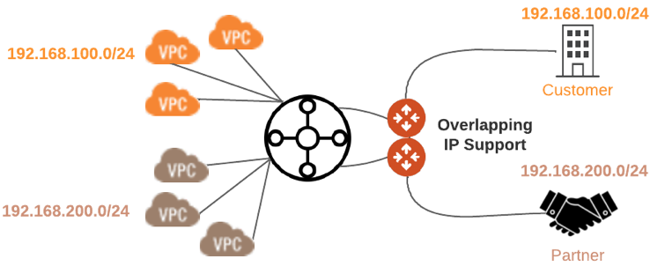
Support Overlapping IP address
Challenge:
IP addressing overlap connecting to external partners / customers / providers
M&A
Connecting different LoBs/App teams
Solution:
Aviatrix Backbone supports multiple ways of solving overlapping IP address problem
Multiple advance SNAT, DNAT, Mapped NAT, Customized NAT options available

Slide 18
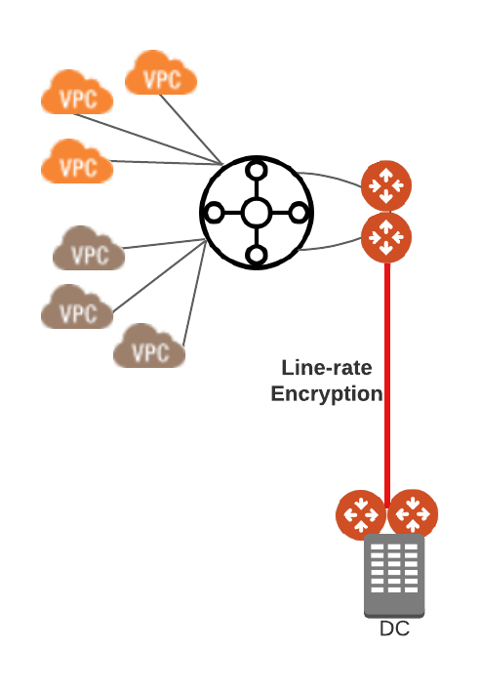
Extend Encryption to On-prem
Challenge:
Connecting to on-prem is un-encrypted over Direct Connect
Using MacSec doesn’t give end-to-end encryption
Using multiple IPSec tunnels in very complex
Solution:
Line-rate encryption of Direct Connect (10 Gbps+)
No need to manage IPSec Tunnels
Leverage virtualized Aviatrix Secure Edge on-prem (Equinix, ESXi, KVM)

Slide 19
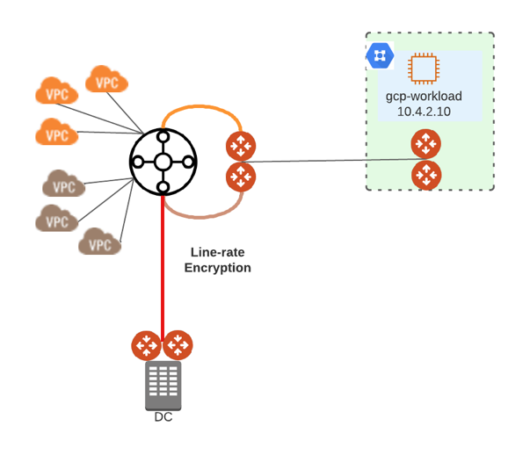
Extend to Any Other CSP
Challenge:
Connecting to a new CSP means new platform design, deploy, enablement
GCP doesn’t have a TGW equivalent
Different toolset for Day2 Ops
Solution:
Extend the same Aviatrix Backbone to another cloud
Either deploy a new Transit or connect the VPC to existing AWS hosted Backbone
Same operational tooling across all clouds

Slide 20
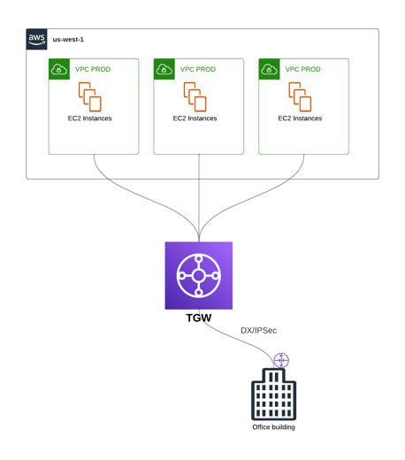
Typical Migration Deployment
Initial environment in a brownfield scenario:
Several Application VPCs that are connected to the TGW as attachments
OnPrem connectivity (hybrid – can be DX/IPSec)

Slide 21
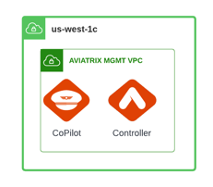
Typical Migration Deployment
Initial environment in a brownfield scenario:
Several Application VPCs that are connected to the TGW as attachments
OnPrem connectivity (hybrid – can be DX/IPSec)
Deploy the Aviatrix Controller and CoPilot in a dedicated VPC, in a different AZ where there are no gateways deployed (best practice)

Slide 22
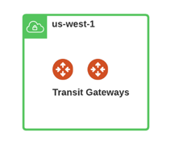
Typical Migration Deployment
Initial environment in a brownfield scenario:
Several Application VPCs that are connected to the TGW as attachments
OnPrem connectivity (hybrid – can be DX/IPSec)
Deploy the Aviatrix Controller and CoPilot in a dedicated VPC, in a different AZ where there are no gateways deployed (best practice)
Deploy a Transit VPC and deploy a pair of Transit Gateways

Slide 23
Typical Migration Deployment
Initial environment in a brownfield scenario:
Several Application VPCs that are connected to the TGW as attachments
OnPrem connectivity (hybrid – can be DX/IPSec)
Deploy the Aviatrix Controller and CoPilot in a dedicated VPC, in a different AZ where there are no gateways deployed (best practice)
Deploy a Transit VPC and deploy a pair of Transit Gateways
Establish a back-to-back connection between the Aviatrix Transit Gateways and the AWS TGW

Slide 24

Typical Migration Deployment
Initial environment in a brownfield scenario:
Several Application VPCs that are connected to the TGW as attachments
OnPrem connectivity (hybrid – can be DX/IPSec)
Deploy the Aviatrix Controller and CoPilot in a dedicated VPC, in a different AZ where there are no gateways deployed (best practice)
Deploy a Transit VPC and deploy a pair of Transit Gateways
Establish a back-to-back connection between the Aviatrix Transit Gateways and the AWS TGW
Deploy the Spoke Gateways inside the Application VPCs (this action will not change any routing)

Slide 25
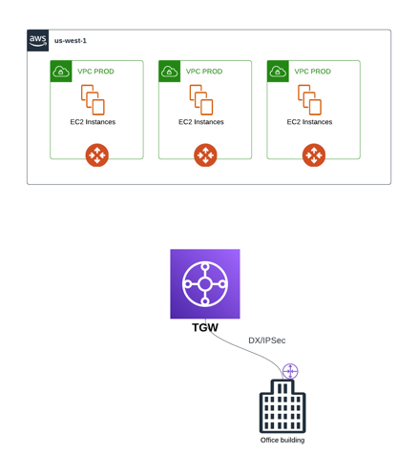
Typical Migration Deployment
Initial environment in a brownfield scenario:
Several Application VPCs that are connected to the TGW as attachments
OnPrem connectivity (hybrid – can be DX/IPSec)
Deploy the Aviatrix Controller and CoPilot in a dedicated VPC, in a different AZ where there are no gateways deployed (best practice)
Deploy a Transit VPC and deploy a pair of Transit Gateways
Establish a back-to-back connection between the Transit Gateways and the TGW
Deploy the Spoke Gateways inside the Application VPCs (this action will not change any routing)
Remove the connections between the VPCs and the TGW and deploy the attachments between the Spoke Gateways and the Transit Gateways

Slide 26
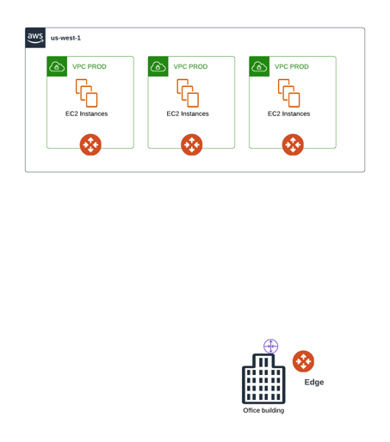
Typical Migration Deployment
Initial environment in a brownfield scenario:
Several Application VPCs that are connected to the TGW as attachments
OnPrem connectivity (hybrid – can be DX/IPSec)
Deploy the Aviatrix Controller and CoPilot in a dedicated VPC, in a different AZ where there are no gateways deployed (best practice)
Deploy a Transit VPC and deploy a pair of Transit Gateways
Establish a back-to-back connection between the Transit Gateways and the TGW
Deploy the Spoke Gateways inside the Application VPCs (this action will not change any routing)
Remove the connections between the VPCs and the TGW and deploy the attachments between the Spoke Gateways and the Transit Gateways
Deploy an Aviatrix Edge and then connect the Edge to the Transit Gateways. If you are not looking for HPE, you can also connect the WAN router as an IPSec connectivity to the Transit Gateways. Last but not least, remove the TGW.

